Slide 1

Bringing new solutions to lending to SMEs
UNCTAD – UNESCAP Asia-Pacific Regional Conference
Bangkok, Thailand
November 21, 2002

Slide 2
Traditional SME lending approach
Consumer Lending
SME Lending
Medium Business to Corporate Lending
Annual Turnover
N/A
US$250,000 to US$15,000,000
> US$15,000,000
Loan Size
Up to US$50,000
US$50,000 to $1,000,000
> US$1,000,000
Lending Basis
Unsecured
Unsecured/Secured
Unsecured/Secured
Loan Application
Retail
Retail/Wholesale
Wholesale
Credit Application Method
Standard simple loan applications
Individually written loan proposal by lending officers
Individual written loan proposal
Loan Underwriting
Quantitative
Quantitative/Qualitative
Quantitative/Qualitative
Credit evaluation criteria
Income Proof
Debt to income ratio
Financial statements
Financial statements
Cash flow statements
Business Plan
Character of entrepreneurs
Cash flow statements
Business Plan
Character of entrepreneurs
Loan Documentation
Simple documents
Complex documents
Complex documents
Loan servicing
Call center with no designated relationship managers
Designated relationship managers
Designated relationship managers
Loan management
Repayment experience and exception transactions
Financial statements
Cash flow statements
Compliance with business plans
Financial statements
Cash flow statements
Compliance with business plans

Slide 3
Rethinking of lending approach
1) Going beyond top tier “SMEs”
  Accept “not so strong” are SMEs are the norm
  Adopt credit card lending thinking and price risk and rewards appropriately
Loan yield of Prime + 1%
Expected loss of 0.5%-1.0%
5%
Top tier SMEs with collateral
or strong balance sheet
90%
Loan yield of Prime + 10%
Expected loss of 1.0% - 5%
Small SMEs with limited
resources, high leverage,
possibly operating losses from
time to time
Loan yield of Prime + 15%
Expected loss of 5%-10%
5%
SMEs that are not viable

Slide 4
Rethinking of lending approach
(2) Seeking new source of information beyond financial statements, cash flow projections and business plans.
Too static and outdated to be relevant in credit decisions
Alternative reliable information that can be obtained from SMEs include:
  Who are customers of SMEs
  How much do SMEs sell to customers?
  How much cash do SMEs collect from customers?
Internet makes it possible for SMEs to provide such information on a timely basis

Slide 5
SMEloan Hong Kong Limited

Slide 6
SMEloan Hong Kong
It leverages the Internet to capture on-going business information from SME borrowers in order to build a dynamic risk management and loan servicing model for SME lending
Loans are extended against the cash flow and business performance and secured by account receivable

Slide 7
Our Risk Approach
Our risk approach is the same as how SMEs extend open account to their own customers.
SMEs extending credit to buyers
SMEloan extending loans to SMEs
Deliver Goods
Sell to debtors
Sell to customers
Invoice debtors
Collect from customers
Collect from debtors
Good customers!!!
Good borrowers
The comfort of extending credit is based on
the continuing “viewing” of customers’
performance
The comfort of SMEloan extending loans is based on
The continued “viewing” of SME’s performance

Slide 8
SMEloan Lending Model
Focus on quantitative data to achieve credit evaluation consistency
- Analyze the triangular relationship between cash flows, sales and account receivable
Manage SME borrowers of higher risks instead of all borrowers
Know which SME borrowers are having problems
Leverage Internet to obtain information from SME borrowers
Reduce loan servicing costs
Empower SMEs to borrow more when they want to
Strengthen customer retention
Focus on segment between US$25K to US$750K loans
Broaden the market you can service
Secured by account receivable
- Effective source of repayment

Slide 9
Cash flow lending and not A/R lending
Combination of strength of two lending practices
“Cash flow lending + Account receivable factoring”
When business and cash flow performs
normally
When business and cash flow performs
poorly and irregularly
Cash Flow
Lending
Minimum
control
Account Receivable
Factoring
Maximum
control

Slide 10
Traditional SME Lending Process vs SMEloan Process
Traditional SME lending is a largely manual relying on human judgment on a case by case basis
Loan
Origination
Loan
Underwriting
Loan
Documentation
Loan
Servicing
Loan
Management
SMEloan process automates data capturing and implement decision standardizations using comprehensive rules
Loan
Origination
Loan
Underwriting
Loan Risk
Management
Loan
Servicing
Online and offline originations
Internet based loan application engine
Instant approval
Supporting documentation to verify information
Company’s sales, accounts receivable and cash are monitored
Exceptions module picks up any irregularities and credit risks
Platform monitors utilization and increases credit limits and service SME borrower temporary needs automatically
Customer Loan
Increase Request

Slide 11
SMEloan data flow
SME 6
SME 4
SME 3
SME clients with exceptions –
6-15% exception clients
SME 1
SME 2
SMEloan
Exception
Engine
SME 1
Provide sales and
Debtor info and
Debtor collection
info
SME 2
SME 5
Good performing SME clients
85-94% good clients
SME 4
SME 3
SME 6
SME 5
Utilizing the exception engine, SMEloan segregates the good and bad risks, SMEloan can
manage risks more appropriately and support good companies effectively.

Slide 12
Results of SMEloan model
Borrowers get more financing when they grow their business, ensuring customers’ loyalty
Achieve scalability and consistency in credit evaluation by focusing only on those borrowers that are showing exceptions. Able to move to resolve problem situations before other creditors know
Reduce credit losses as SMEloan “know” the business performance of borrowers on a real time basis.

Slide 13
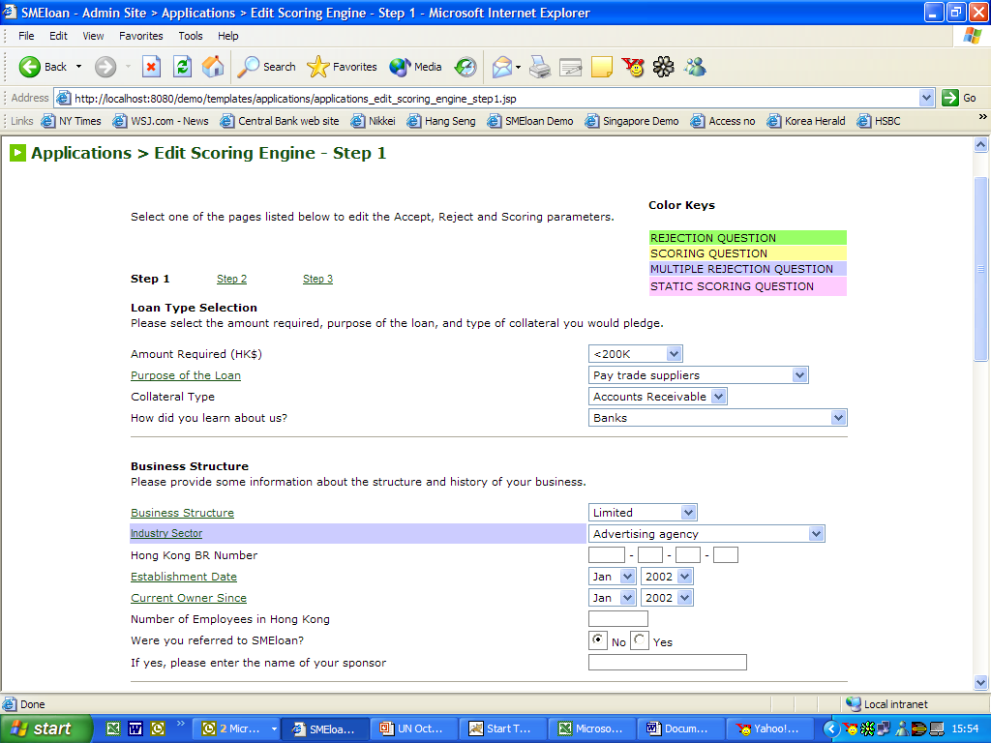
Web loan applications – Step 1
Applications, online and offline, are screened through a central web engine which defines profiles of SMEs that
are acceptable as clients by SMEloan. Step 1 finds out the background of applicants.

Slide 14
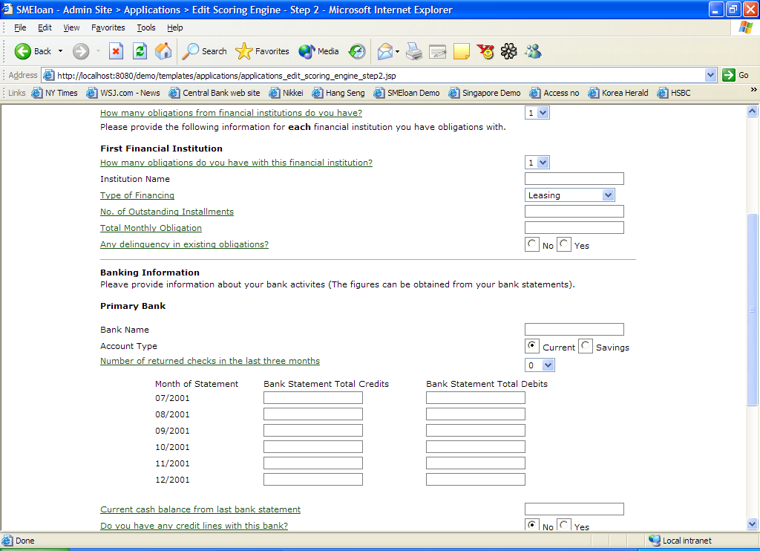
Web loan applications – Step 2
Applications, online and offline, are screened through a central web engine which defines profiles of SMEs that
are acceptable as clients by SMEloan. Step 2 finds out banking and finance relationship.

Slide 15
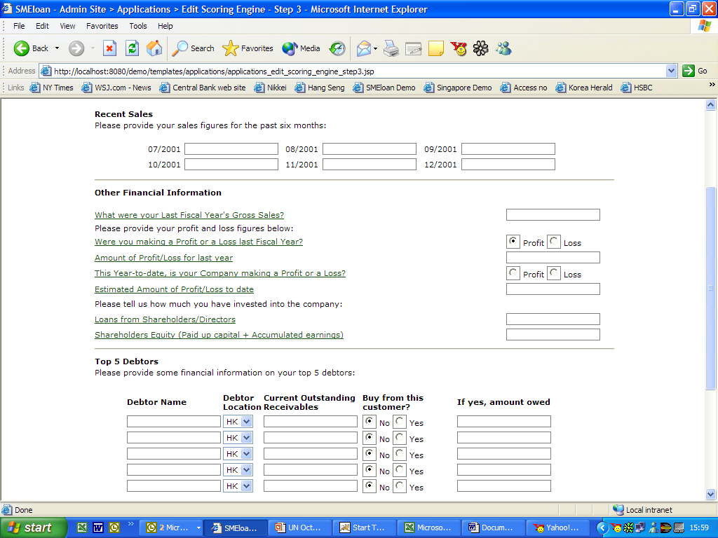
Web loan applications – Step 3
Applications, online and offline, are screened through a central web engine which defines profiles of SMEs that
are acceptable as clients by SMEloan. Step 3 finds out applicant’s business performance.

Slide 16
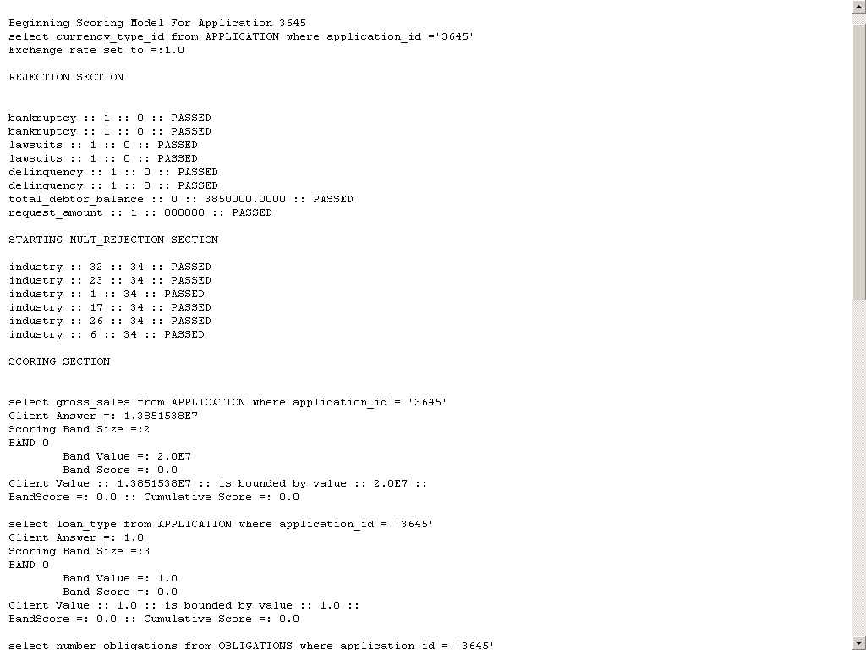
Web loan applications – Audit trail
Applications are processed by Web approval engine with the following audit trails.

Slide 17
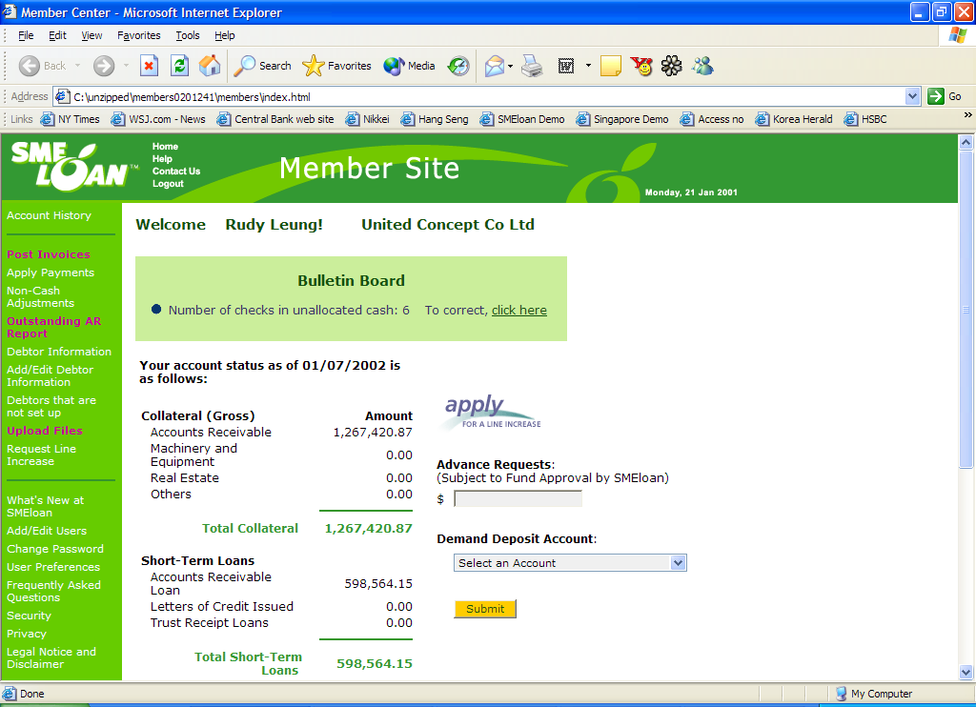
Member Site
SME clients are given an individual site to provide information via the Internet

Slide 18
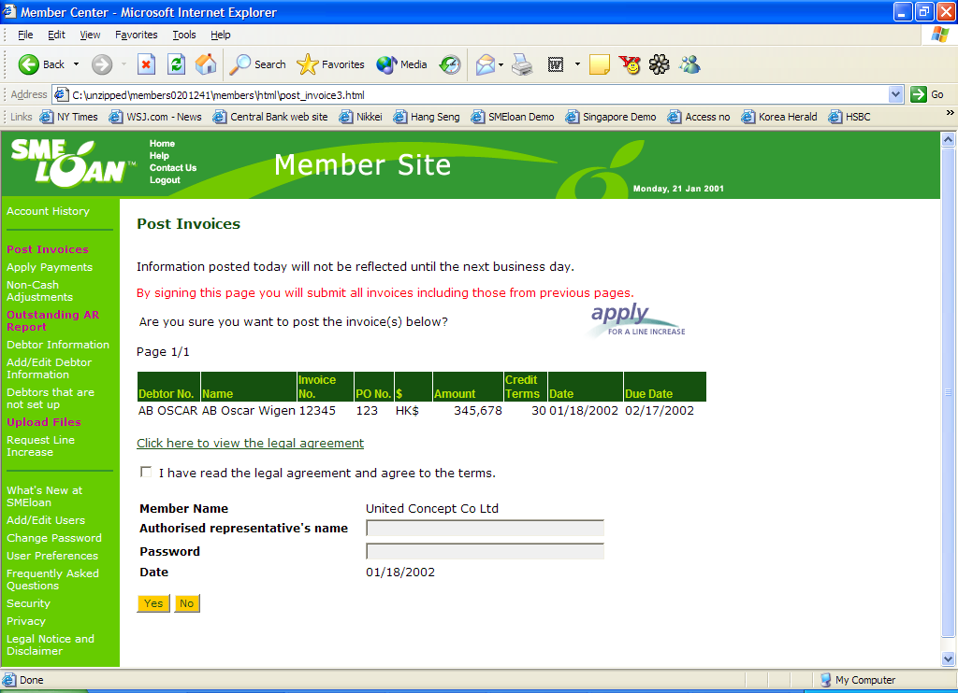
Member Site
SME clients without computer and accounting system can input transactions individually.

Slide 19
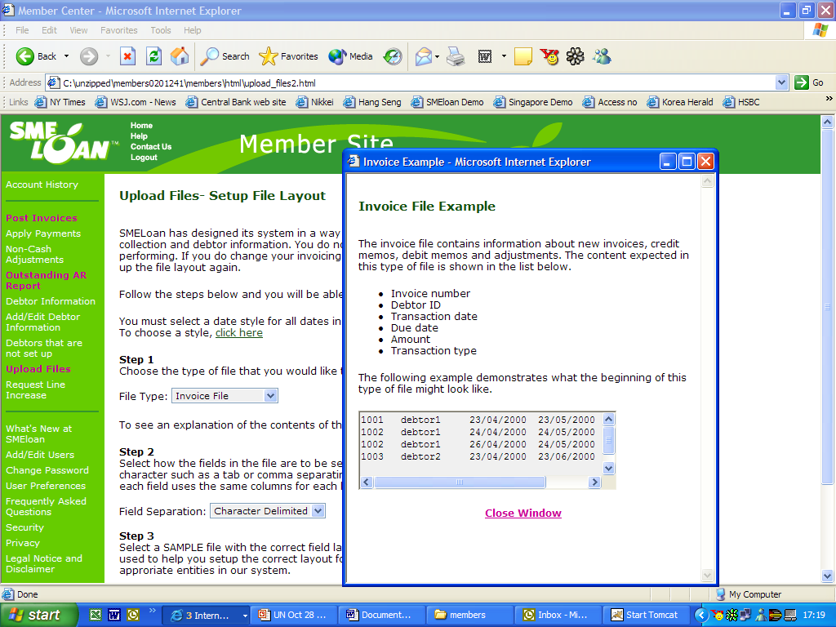
Member Site
SME clients with accounting system can simply upload data directly from accounting systems

Slide 20
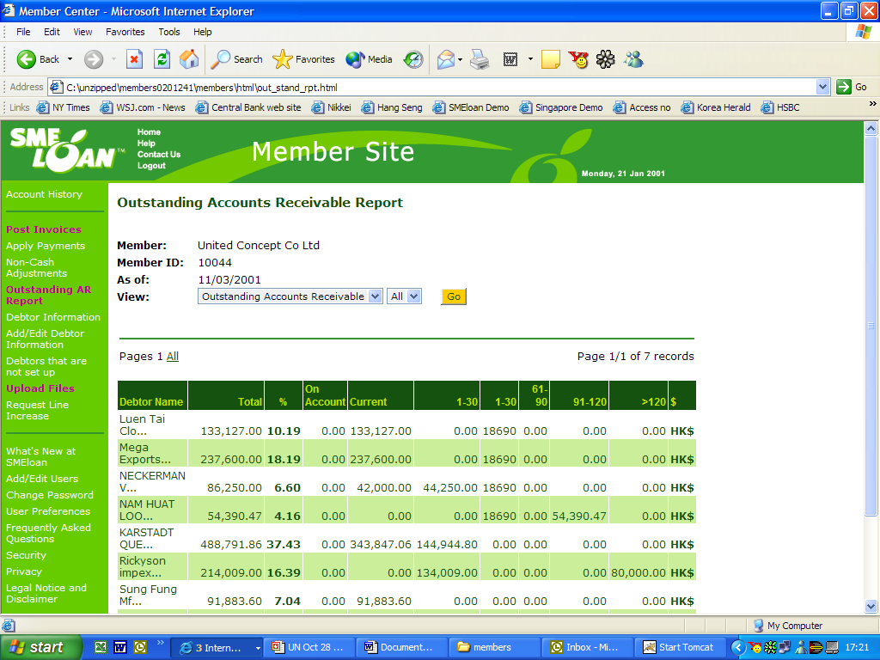
Member Site
Information supplied by SMEs are organized for their uses

Slide 21
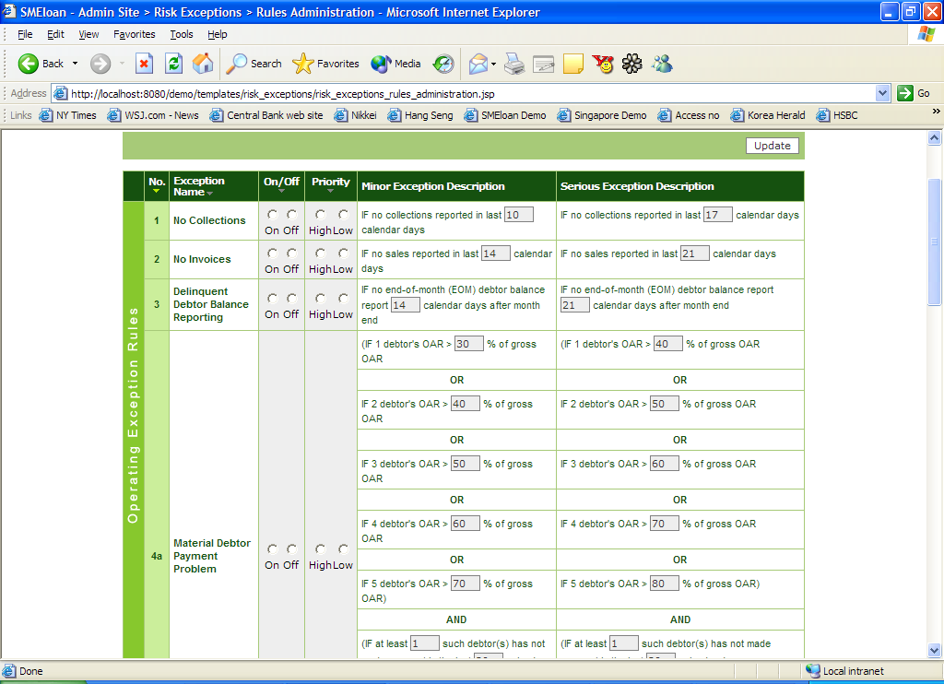
Exception Module
Pre-set rules established to identify operating problems of SMEs before problems deteriorate too far

Slide 22
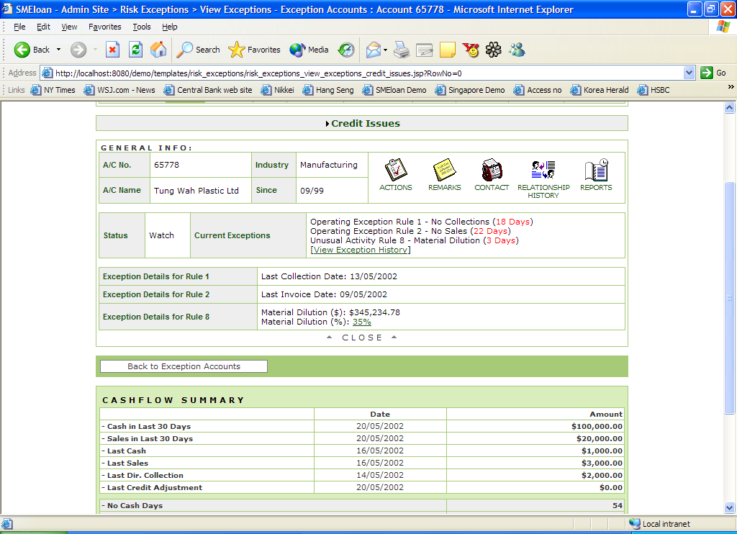
Exception Account Management
System screens out data an displayed online allowing SMEloan to drill down to engage SMEs in explaining
Causes of problems. SMEloan ascertain the viability of the company on a real time basis.

Slide 23
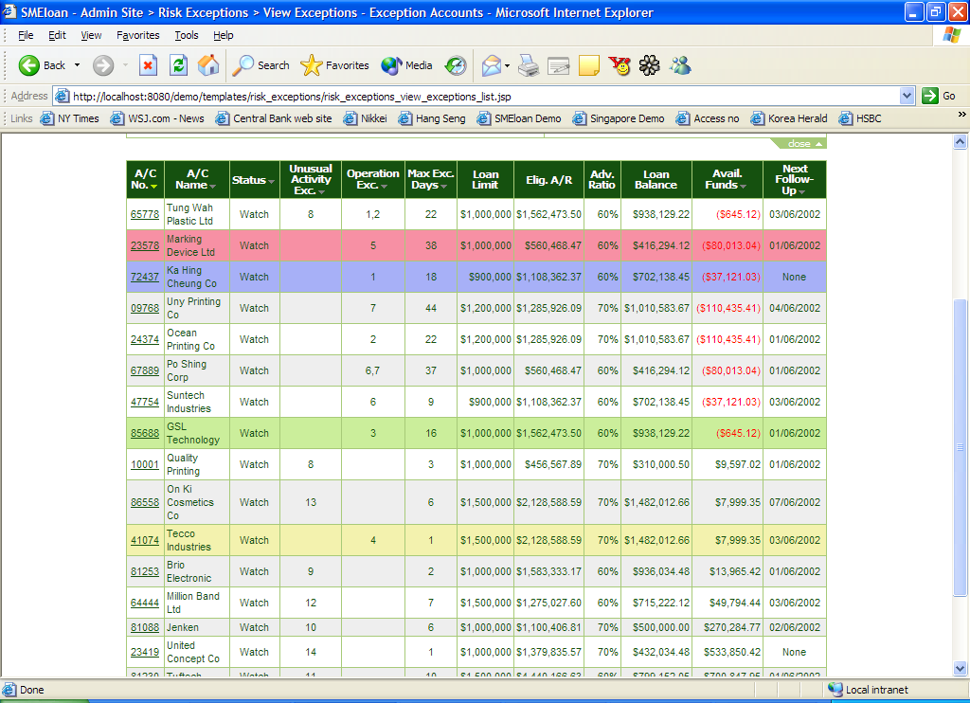
Exception Accounts Overview
Problematic SMEs are identified by system rules, resulting in greater efficiency in risk controls

Slide 24
What we learn?
Lending to SMEs can be done without credit bureau and vast amount of business data
Risks can be managed by obtaining on-going business information from SME borrowers
Lending to SMEs is the most effective way to move SMEs online
Web based system allows quick deployment
Web scoring engine, and risk management system and operating process are easy to understand and do not require experienced SME lending professionals

Slide 25
Important requirements to development of financing for SMEs
Removal of cap on interest rate that financial institutions can charge to SMEs, distorting the risk reward relationship
Development of legal system that could allow financial institutions to obtain and enforce security
Minimum Government loan guarantee programs which tend to discourage financial institutions from making significant commitment into lending to SMEs

